Slide 1
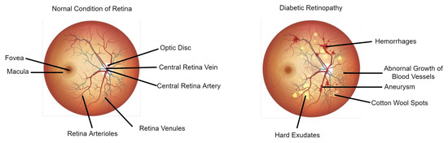
“Diagnosis of Diabetic Retinopathy Using Fundus Images By Machine learning Algorithm”
Submitted to,
“PROF. DR. MD. ASRAF ALI”
Professor , Computer Science
Faculty Of Science & Technology
American International University-Bangladesh
Course: Machine Learning Section: “A”

Slide 2
Group Members
01
BISHANATH TARAFDER
03
MD. GOLAM RABBANI FAHAD
Student ID: 19-41827-3
Student ID: 19-41612-3
02
KAZI EMADUZZAMAN GELANI
05
A.S.M. SADMAN SAKIF
Student ID: 19-41678-3
Student ID: 19-41499-3

Slide 3
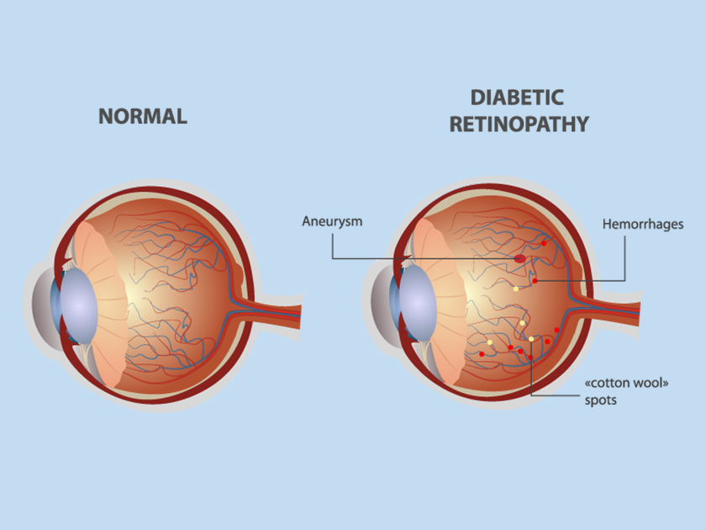
Problem Statement
Diabetic retinopathy is one of the eye complications caused by the diabetes mellitus, which causes other problems such as stroke, cardiovascular disease, diabetic nephropathy and diabetic neuropathy. Diabetes mellitus produces damage to retinal capillaries and it can be visualized only in the retina, a transparent tissue of several different layers of cells. Diabetic retinopathy results in visual disturbances and can lead to permanent blindness. Therefore, an effective diabetic retinopathy screening is essential for early treatment, along with an effective risk factor management to prevent diabetic complications and reduce morbidity and mortality impact.

Slide 4
Objective
To develop a classification model with better accuracy that can diagnose Diabetic retinopathy using fundus images which will be used to early detection of diabetic retinopathy.

Slide 5
Mythology
01
02
Data Preprocessing and Normalization
Diagrams
04
03
Mythology
Classification Algorithms
Feature Extraction Procedure
07
05
0
6
Data Analysis Techniques
Confusion Matrix
ROC Curve

Slide 6
Data Preprocessing and Normalization
# Define the directory that contains the fundus images
dir_path = 'D:/ML using python/Project final/new'
# Define the image size
img_size = (256, 256)
def preprocess_images(dir_path, img_size):
# Get the list of image file names
file_names = os.listdir(dir_path)
# Create an empty NumPy array to store the preprocessed images
preprocessed_images = np.empty((len(file_names), img_size[0], img_size[1], 3))

Slide 7
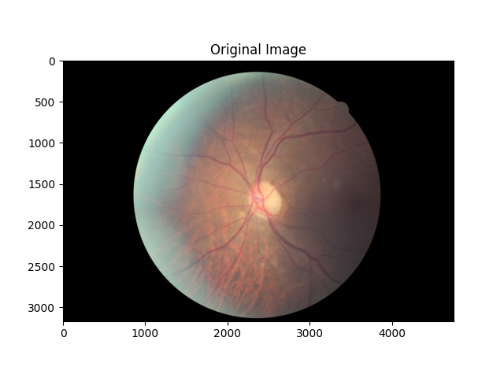
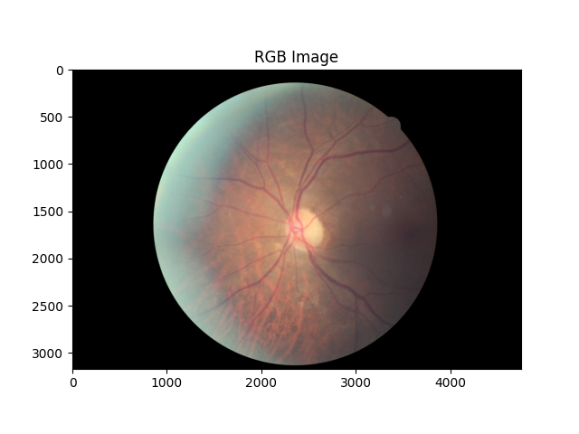
Data Preprocessing and Normalization
# Create an empty NumPy array to store the preprocessed images
preprocessed_images = np.empty((len(file_names), img_size[0], img_size[1], 3))
# Loop over the image file names and preprocess each image
for i, file_name in enumerate(file_names):
# Load the image
img = cv2.imread(os.path.join(dir_path, file_name))
# Convert the image to RGB
rgb = cv2.cvtColor(img, cv2.COLOR_BGR2RGB)

Slide 8
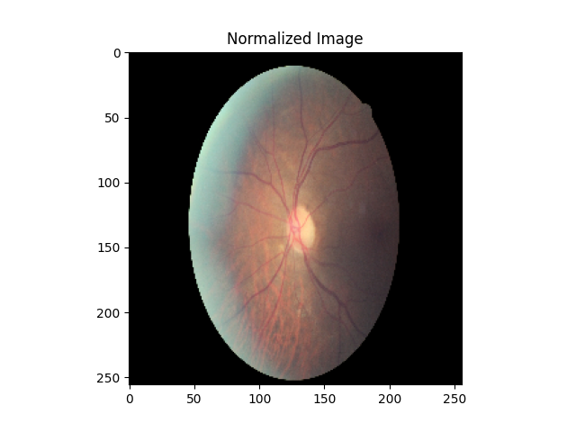

Data Preprocessing and Normalization
# Normalize the pixel intensities
normalized = resized / 255.0
# Resize the image
resized = cv2.resize(rgb, img_size)
# Store the preprocessed image in the NumPy array
preprocessed_images[i] = normalized
Finally, the function returns the preprocessed images as a NumPy array.
return preprocessed_images
To preprocess the images, the "preprocess_images" function is called with the directory path and image size as input. The resulting preprocessed images are stored in a NumPy array called "preprocessed_images".
# Preprocess the images
preprocessed_images = preprocess_images(dir_path, img_size)
This code performs preprocessing and normalization steps on the fundus images, which is a necessary step before we can be used for machine learning tasks such as training and testing classification models for diagnosing Diabetic Retinopathy.

Slide 9
Feature Extraction Procedure and Normalization
For the project of diagnosing Diabetic Retinopathy using Fundus Images, some of the feature extraction techniques that we have used are:
Local Binary Pattern (LBP): This technique is based on the texture information present in the image and can capture the structural information of the retina.
Histogram of Oriented Gradients (HOG): This technique can capture the edge and gradient information of the image, which can be used to identify the blood vessels present in the retina.
Convolutional Neural Networks (CNN): This is a deep learning technique that can be used to automatically learn the features from the images. CNN has shown great success in image classification tasks and can be used to identify different stages of Diabetic Retinopathy.
Gabor Wavelet Transform (GWT): This technique can capture the texture and frequency information present in the image, which can be used to detect abnormalities in the retina.

Slide 10
pre-trained VGG16 model:
# Extract features using pre-trained VGG16 model
base_model = VGG16(weights='imagenet', include_top=False, input_shape=img_size+(3,))
X_train_features = base_model.predict(X_train)
X_test_features = base_model.predict(X_test)
# Reshape the features for feeding to CNN model
X_train_features = X_train_features.reshape(X_train_features.shape[0], -1)
X_test_features = X_test_features.reshape(X_test_features.shape[0], -1)
# Normalize the data
X_train_norm = X_train_features / X_train_features.max()
X_test_norm = X_test_features / X_train_features.max()

Slide 11
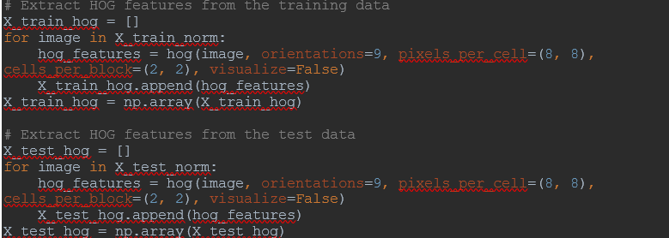
Feature Extraction Procedure and Normalization
Histogram of Oriented Gradients (HOG):

Slide 12
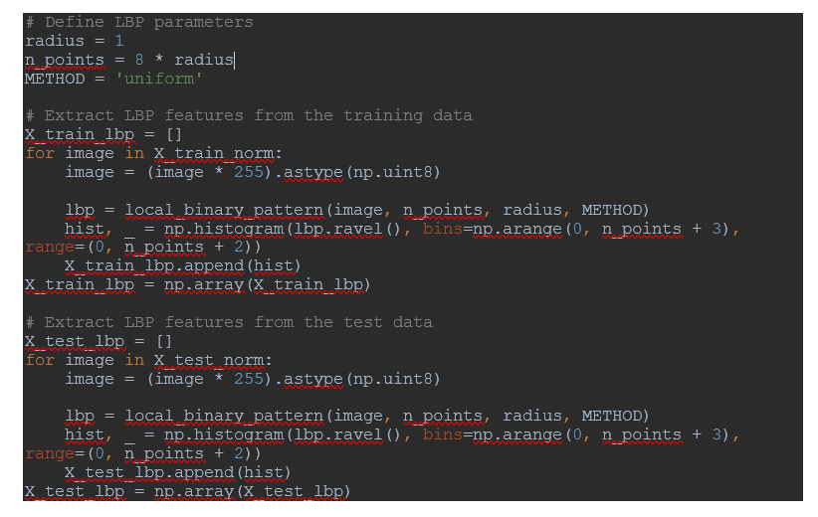
Feature Extraction Procedure and Normalization
Local Binary Pattern (LBP):

Slide 13
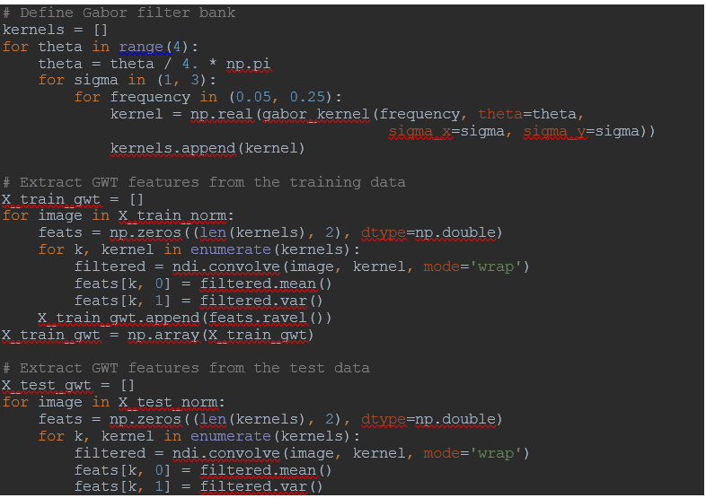

Feature Extraction Procedure and Normalization
Gabor Wavelet Transform (GWT):

Slide 14
Classification Algorithms:
There are several machine learning algorithms that we have used for the diagnosis of diabetic retinopathy using fundus images:
Convolutional Neural Networks (CNN): CNNs have shown promising results in image classification tasks and have been widely used for diabetic retinopathy diagnosis. They can automatically learn relevant features from the input images, which makes them particularly suitable for this type of task.
Support Vector Machines (SVM): SVM is a powerful algorithm for binary classification tasks. It works by finding the hyperplane that separates the data points of different classes with the maximum margin. SVM has been shown to perform well in diabetic retinopathy classification.
Random Forest (RF): RF is an ensemble learning method that combines multiple decision trees to improve the accuracy of the model. RF has been shown to perform well in diabetic retinopathy classification tasks.
K-Nearest Neighbors (KNN): KNN is a simple but effective algorithm for classification tasks. It works by finding the k closest data points to the input image and assigning the class that is most frequent among these neighbors. KNN has been used successfully for diabetic retinopathy classification.

Slide 15
Convolutional Neural Networks (CNN):
# Define the model architecture
model = Sequential()
model.add(Conv2D(32, (3, 3), activation='relu', input_shape=(128, 128, 3)))
model.add(MaxPooling2D((2, 2)))
model.add(Conv2D(64, (3, 3), activation='relu'))
model.add(MaxPooling2D((2, 2)))
model.add(Conv2D(64, (3, 3), activation='relu'))
model.add(Flatten())
model.add(Dense(64, activation='relu'))
model.add(Dense(1, activation='sigmoid'))
# Compile the model
model.compile(optimizer='adam',
loss='binary_crossentropy',
metrics=['accuracy'])
# Train the model on the data
model.fit(train_images, train_labels, epochs=10, batch_size=32, validation_data=(test_images, test_labels))

Slide 16
Support Vector Machines (SVM):
# Train and evaluate the SVM model
svm = SVC(kernel='linear', C=1, random_state=42)
svm.fit(X_train_norm.reshape(X_train_norm.shape[0], -1), y_train)
svm_acc = svm.score(X_test_norm.reshape(X_test_norm.shape[0], -1), y_test)
svm = SVC(kernel='linear', C=1, random_state=42)
svm.fit(X_train_norm.reshape(X_train_norm.shape[0], -1), y_train)
svm_acc = svm.score(X_test_norm.reshape(X_test_norm.shape[0], -1), y_test)

Slide 17
Random Forest (RF):
# Train and evaluate the Random Forest model
rf = RandomForestClassifier(n_estimators=100, random_state=42)
This line creates an instance of the RandomForestClassifier class and initializes it with n_estimators=100 and random_state=42. n_estimators specifies the number of decision trees in the random forest, while random_state ensures that the random number generator used for initializing the forest is seeded with a fixed value for reproducibility.
rf.fit(X_train_norm.reshape(X_train_norm.shape[0], -1), y_train)
This line trains the random forest model using the training data X_train_norm and their corresponding labels y_train. X_train_norm is reshaped into a 2D array using .reshape(X_train_norm.shape[0], -1) so that each image in the training set is flattened into a 1D array.
rf_acc = rf.score(X_test_norm.reshape(X_test_norm.shape[0], -1), y_test)
This line evaluates the accuracy of the trained model on the test data. rf.score computes the mean accuracy of the random forest classifier on the test data, given X_test_norm and y_test, and returns a scalar value between 0 and 1 representing the accuracy.
y_pred_rf = rf.predict(X_test_norm.reshape(X_test_norm.shape[0], -1))

Slide 18
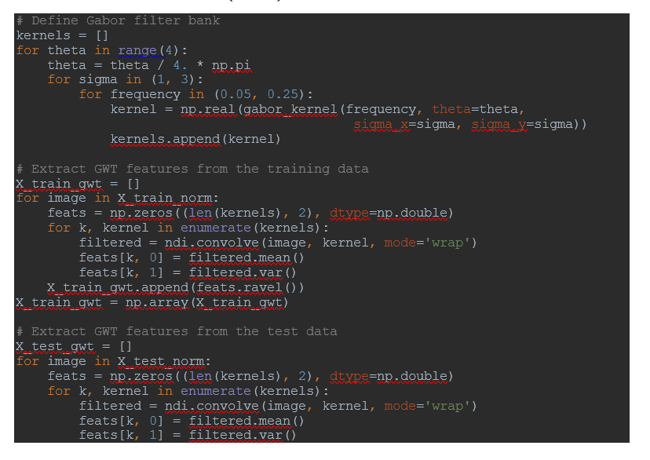
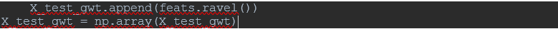
Gabor Wavelet Transform (GWT):

Slide 19
K-Nearest Neighbors (KNN):
# Train and evaluate the KNN model
knn = KNeighborsClassifier(n_neighbors=5) # Initialize KNN classifier with 5 neighbors
knn.fit(X_train_norm.reshape(X_train_norm.shape[0], -1), y_train) # Fit the model on training data
knn_acc = knn.score(X_test_norm.reshape(X_test_norm.shape[0], -1), y_test) # Evaluate the model accuracy on test data
y_pred_knn = knn.predict(X_test_norm.reshape(X_test_norm.shape[0], -1)) # Predict the labels of test data using the trained model

Slide 20
Data Analysis Techniques:
There are several machine learning algorithms that we have used for the diagnosis of diabetic retinopathy using fundus images:
Confusion matrix
ROC (Receiver Operating Characteristic)curve.
Confusion matrix and ROC curve are both commonly used evaluation metrics for classification models in machine learning.
A confusion matrix is a table that is used to evaluate the performance of a classification model by comparing the actual labels with the predicted labels. It is a table with four possible outcomes of a binary classification model: true positive (TP), false positive (FP), true negative (TN), and false negative (FN).

Slide 21
Data Analysis Techniques:
Here's an example of a confusion matrix:
Actual \ Predicted Positive Negative
Positive TP FN
Negative FP TN
The confusion matrix is useful for calculating different evaluation metrics like accuracy, precision, recall, and F1-score.
The ROC (Receiver Operating Characteristic) curve is a graphical representation of the performance of a binary classification model. The ROC curve is created by plotting the true positive rate (TPR) against the false positive rate (FPR) at different classification thresholds.

Slide 22
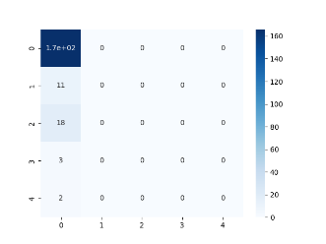

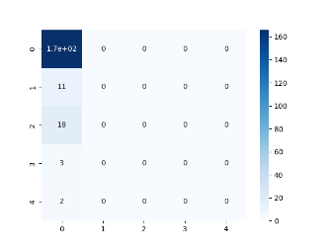

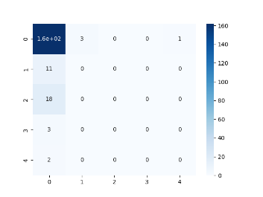
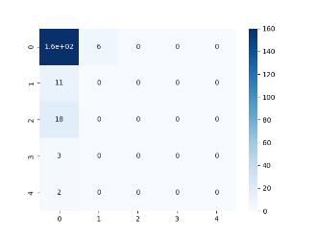
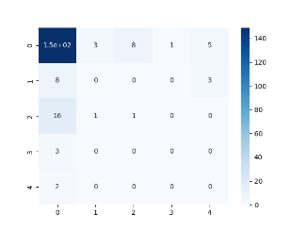

Results and Discussion
Results Comparison
CNN with VGG16 model accuracy: 0.8299999833106995
CNN accuracy: 0.8299999833106995
Random Forest with HOG features accuracy: 0.83
SVM with HOG features accuracy: 0.83
KNN with HOG features accuracy: 0.83
Random Forest with LBP features accuracy: 0.81
SVM with LBP features accuracy: 0.8
KNN with LBP features accuracy: 0.83
Random Forest with GWT features accuracy: 0.75
SVM with GWT features accuracy: 0.83
KNN with GWT features accuracy: 0.835
Confusion Matrix Analysis

Slide 23
Confusion Matrix Analysis

Slide 24
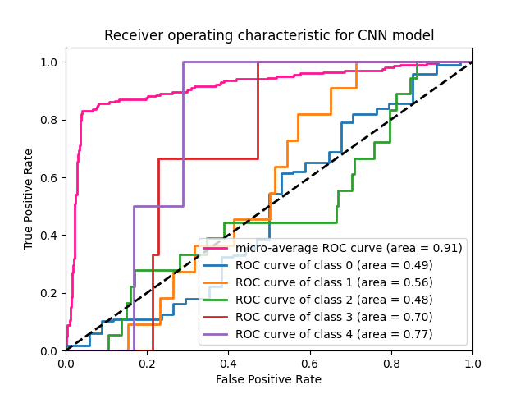
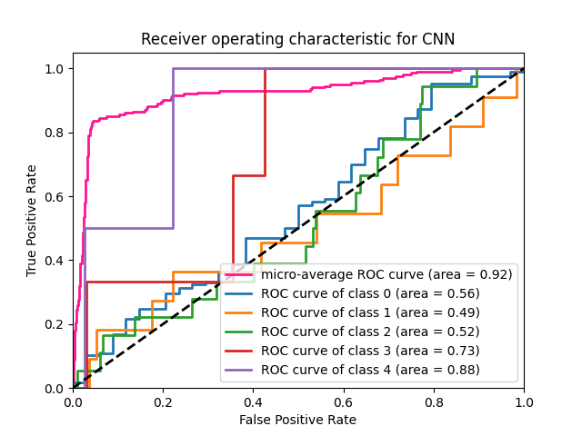
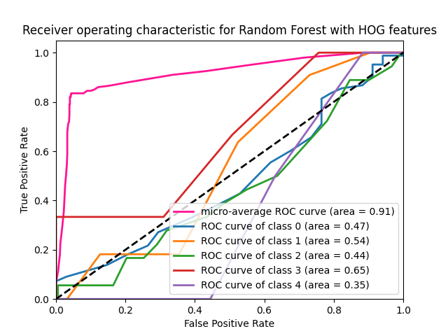
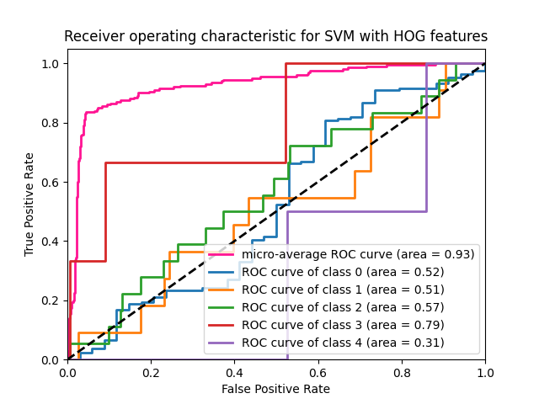
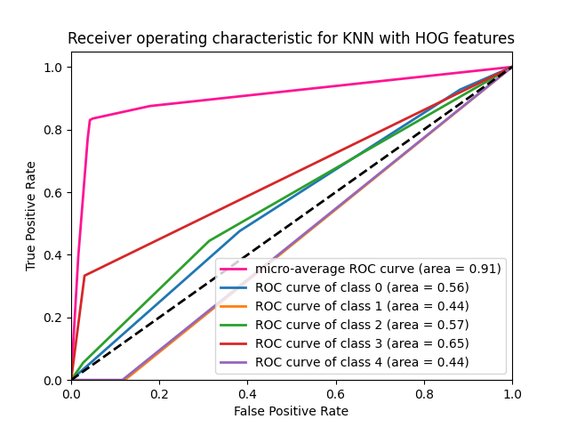
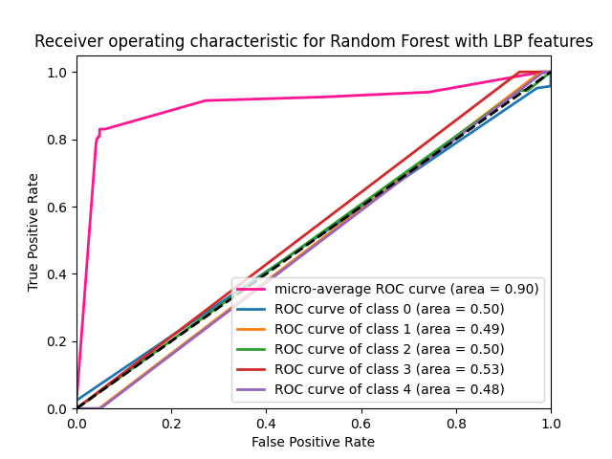
Graphical Representation of Results:

Slide 25
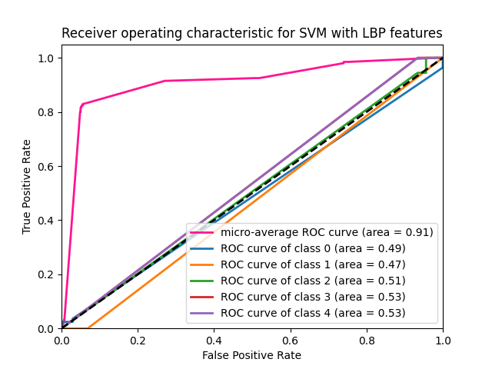
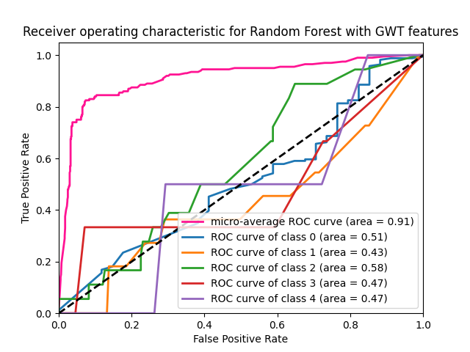
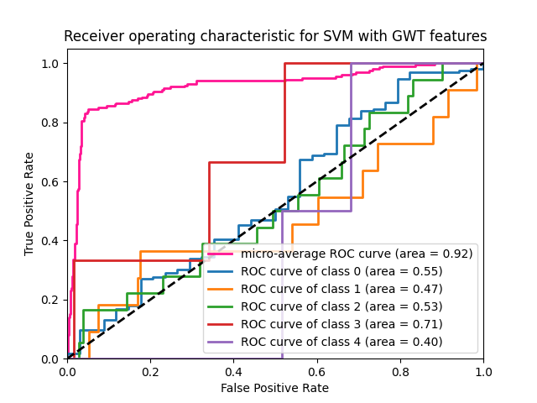
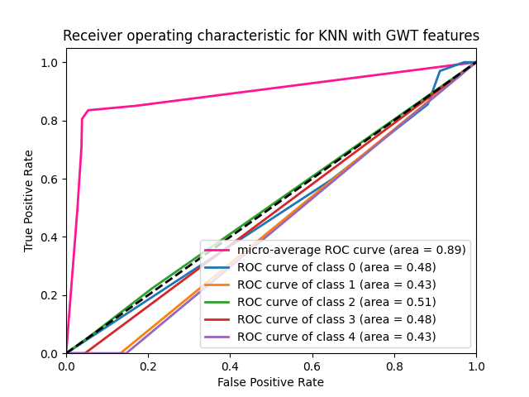
Graphical Representation of Results:

